Slide 1




MAJOR PROJECT REPORT

Slide 2
PROJECT REPORT BY –
BCA 6th SEMSETER
Group - 10
Name | Roll no.
Md. Azmat Ansari | 40
Md Samir | 42
Md Fardeen Moiz | 45
Nikhil Singh | 33
Jalmejay Kumar Shaw | 37

Slide 3

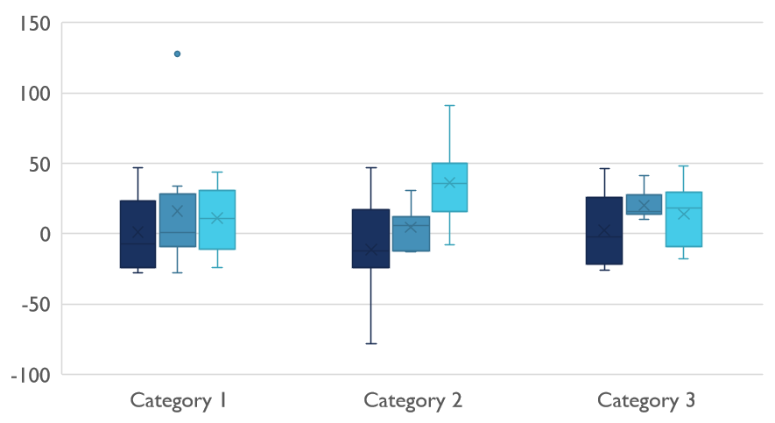
COMPETITIVE LANDSCAPE
UNDER THE PROJECT GUIDANCE
OF
Mr. AMITAVA CHAKRABORTY

Slide 4

CONTENTS
ACKNOWLEDGMENT
OBJECTIVE
SYSTEM REQUIREMENT SPECIFICATION
WHAT IS ANDROID DEVELOPMENT ?
WHAT IS XML ?
PROJECT
BIBLIOGRAPHY

Slide 5

ACKNOWLEDGEMENT
We would like to express my gratitude towards Mr. Amitava Chakrabortyfor guiding me and my Team Members throughout the Project as well as our HOD Sir Dr. Dibyendu Kumar Pal, who gave us the golden opportunity to do this wonderful project.
I feel thankful and express my kind gratitude towards my Team Members : Md. Azmat Ansari, Md. Fardeen Moiz, Md. Samir, Jalmejay Kumar Shaw and Nikhil Singh for helping and supporting me , As this is a complete team work so without their cooperation it was not possible to complete our Major Project titled “ eCoursely “.
Our Project is done under the supervision of our Guide Mr. Amitava Chakraborty. I thank all participants for their positive support and guidance.
Md. Azmat Ansari
Nikhil Singh
Md. Samir
Md.Fardeen Moiz
Jalmejay Kumar Shaw

Slide 6
INTRODUCTION
The project's name is "eCoursely." eCoursely is an android application that has general questions related to college Courses and others. It has multiple choice questions with time limit and it also calculate scores of each correct answer. It is good for students of every age group it helps in increasing general knowledge about world Sports and computer etc. Don't need register simply give any user name and password it will saved automatically and you can login again with same user name and password don't have to worry about the past score. The application helps the user to increase his/her knowledge. Since Smartphone mobiles are being widely used by general population and students, the Coursely application can provide on the Student's mobile. eCoursely is a application developed to conduct an quiz based on time constraints. eCoursely system is accessed by entering the user name and password which is added to the database. Before start of the quiz, the rules and regulations are displayed that includes description of the time limit, number of questions to be answered and scoring methods. Assessment is started by displaying one question with four options each based on computer and general knowledge.

Slide 7

OBJECTIVE
The main objective of “eCoursely" is to facilitate a user friendly environment for all users and reduces the manual effort. In past days assessment is conducted manually but in further resolution of the technology we are able to generate the score and pose the queries automatically. The functional requirements include to create users that are going to participate in the quiz, automatic score and report generation and administrative tasks like add, delete, update for admin privilege users. In this application, all the permissions lies with the administrator i.e. specifying the details of the quiz with checking result will show to interviewee or not, addition of question and answers, marks for each question, Set timer for each quiz and generate report with score for each Assessment.

Slide 8

SYSTEM REQUIREMENT SPECIFICATION
Hardware Requirement
Processor : Intel i5 or higher
Main Memory (RAM) : 4 GB
Cache Memory :512 KB
Hard disk : 100GB
SoftwareRequirement
Windows 10 or higher
Android Studio
Android Virtual Device (AVD)
Frontend & Backend development
XML
JAVA
Firebase

Slide 9

WHAT IS ANDROID DEVELOPMENT ?
Any application developed to be supported by the Android Operating system using
the android software development kit on android studio is the process of android development.
The open-source operating system designed by Google especially for mobiles is Android.
Android OS has been developed using Linux Kernel.
Because of the ability of easily modifiable , most of the android developers have
used different GUIs even when all of them use the same basic operating system.
Any application for android system can be easily created by installing the freely available SDK.
These applications support any device which is built in android OS and written In Java.
With over 2 million monthly active users, Android has been the most best-selling OS since 2011.
The libraries are the basic tools for the development of the android applications.
Some of the libraries used in android development and their main features are: android.app:
The basic for all the android applications is this library which is the key that provides access to
the model of the application.android.database: The main database supported by the android is SQLite and
this library is used to connect the application to the database and access its data via the content providers.
android. text: The library which supports text manipulation and which enable the application to render the
text graphics on the android device.android.view: This key of the application development which supports
the user interface alteration.

Slide 10

WHAT IS XML ?
XML stands for Extensible Markup Language. XML is a markup language much like HTML used to describe data.
It is derived from Standard Generalized Markup Language. Basically, the XML tags are not predefined in XML.
In Android, the XML is used to implement UI-related data, and it’s a lightweight markup language that doesn’t make layout heavy.
XML only contains tags, while implementing they need to be just invoked.
Basically in Android XML is used to implement the UI-related data. So understanding the core part of the UI interface with respect to XML is important.
Considering the following simple example of the activity_main.xml file.
The colors.xml file is responsible to hold all the types of colors required for the application.
It may be primary brand color and its variants and secondary brand color and its variants.

Slide 11
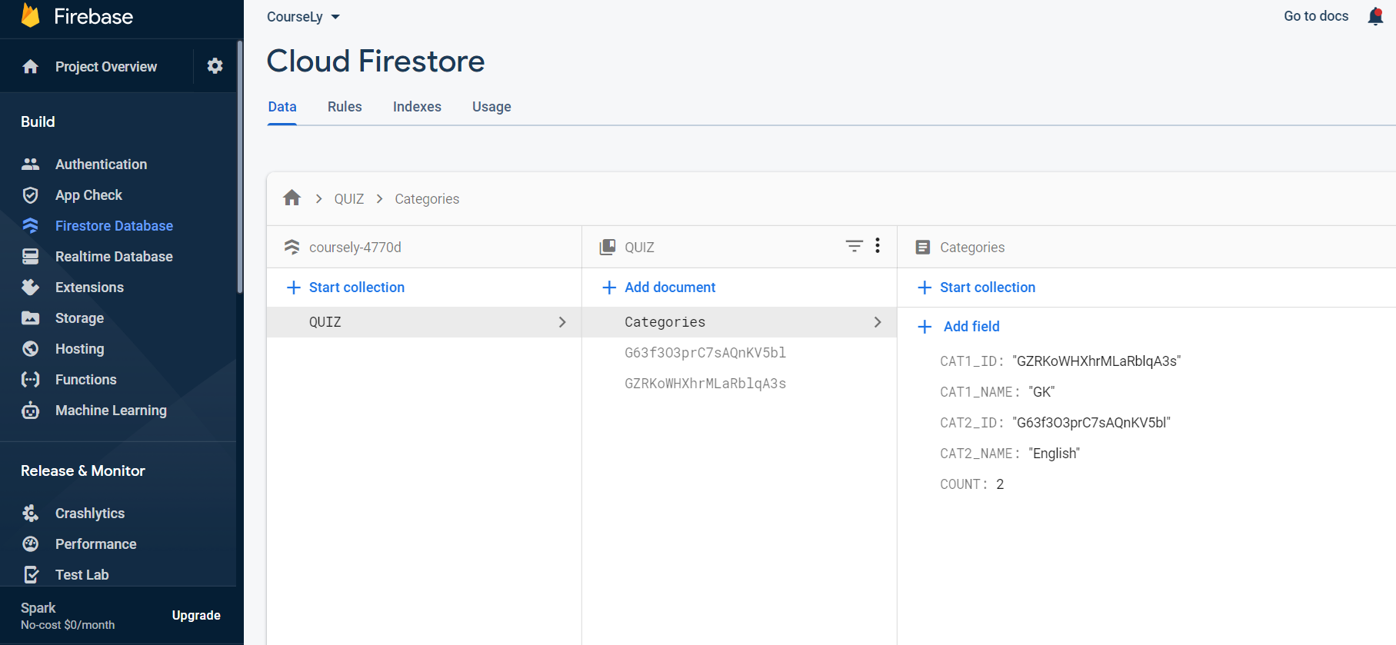
FIREBASE
Firebase is a famous product of Google which is used by so many developers to add backend functionality for their website as well as apps. The Firebase will make your job really easier for the backend database and handling the database. In this article, we will take a look at the implementation of the Firebase FireStore Database in Android. In this article, we will be adding an Email and password authentication inside our app and along with that, we will be performing the CRUD (Create, Read, Update and Delete) operations inside our application using the Firebase FireStore Database.

Slide 12

PROJECT
eCoursely is an android application that has general questions related to programming language . It has multiple choice questions with time limit and it also calculate scores of each correct answer. It is good for students of every age group it helps in increasing knowledge about programming languages and computer etc. To use this app you Don't need register simply Install App and Press Start Button, then choose your Category, then sets your Assessment will start after completing all question it shows your score, this app is very much helpful for increasing knowledge and completing question on time helps in time management .

Slide 13
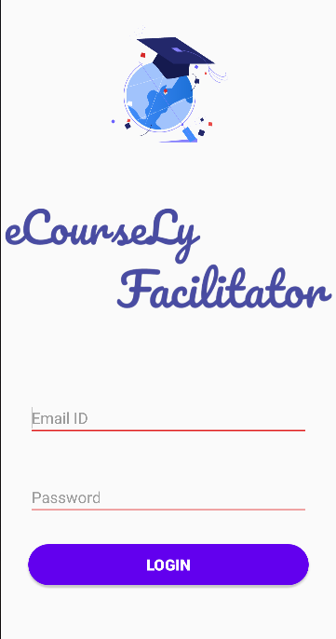
FACILITATOR
When we will open facilitator app then a field of email id and password is shown facilitator has to provide their registered email id and password and click on the login Button. And you get successfully logged in, Then appers the category of subjects present in the facilitator app,user can easily delete, update or can Add content and save it automatically.

Slide 14

BIBLIOGRAPHY
References for the Project Development Were Taken From the following Web Sites and References
References
1. CMC study material
Websites
www.geeksforgeeks.org
www.daniweb.com
www.stackoverflow.com

Slide 15
CONCLUSION
In the conclusion we would like to say that we are thankful to
our teacher for completion of the project.
This is a big idea in small package. In future we were do more
work to give it real life view.
We think this project were help us to guide in future career to step ahead.
This is not a real life project. we just did it as our student project to add in our course. Like the things this projects also has some limitations and can further be enhances by someone, because there are certain drawbacks that do not permit the system to be 100% accurate.

Slide 16


THANK YOU

